Slide 1

In The Name of God
Find the Minimum value in an Array by multithreading!
*these slides are considered just for your use! please avoid from publishing it, thank you.

Slide 2
Solution overview
Suppose we have an array of size 8:
9 8 2 1 5 4 7 3
The number of threads = stride = size/2 = 8/2 = 4
So at first we have 4 threads:
Thread 0
Thread 1
Thread 2
Thread 3

Slide 3
Solution overview
a[0] a[1] a[2] a[3] a[4] a[5] a[6] a[7]
9 8 2 1 5 4 7 3
For thread 0: t=0 and comparison between a[t] & a[t+stride] → a[0] vs a[4]
For thread 1: t=1 and comparison between a[t] & a[t+stride] → a[1] vs a[5]
For thread 2: t=2 and so on
For thread 3: t=3 and so on
Note the Color of any Element:
9 8 2 1 5 4 7 3

Slide 4
Solution overview
9 8 2 1 5 4 7 3
Thread 0 compares a[t]=9 and a[ t+stride ]=5: a[t] > a[ t+stride ] → it executes a[t]=a[ t+stride ] :
5 8 2 1 5 4 7 3
Point: you can swap 5 and 9 or not: here I don’t swap them. If you swap them the array will be as below:
5 8 2 1 9 4 7 3

Slide 5
Solution overview
After finishing thread 1: (Thread 1 execute a[t] = a[ t+stride ])
5 4 2 1 9 4 7 3
Thread 2 doesn’t change anything because a[t] < a[ t+stride]
5 4 2 1 9 4 7 3
Thread 3 doesn’t change The array too:
5 4 2 1 9 4 7 3

Slide 6
Solution overview
a[0] a[1] a[2] a[3] a[4] a[5] a[6] a[7]
5 4 2 1 5 4 7 3
When all threads finished, It’s time to compute the new value of stride:
Stride = stride /2 = 4/2 = 2
So we have two threads:
Thread 0
Thread 1
For thread 0: t=0 and comparison between a[t] & a[t+stride] → a[0] vs a[2]
For thread 1: t=1 and comparison between a[t] & a[t+stride] → a[1] vs a[3]
Note the Color of any Element:
5 4 2 1 5 4 7 3

Slide 7
Solution overview
5 4 2 1 5 4 7 3
Thread 0 compares a[t]=5 and a[ t+stride ]=2:
a[t] > a[ t+stride ] → it executes a[t]=a[ t+stride ] :
2 4 2 1 5 4 7 3
Thread 0 compares a[t]=4 and a[ t+stride ]=1:
a[t] > a[ t+stride ] → it executes a[t]=a[ t+stride ] :
2 1 2 1 5 4 7 3

Slide 8
Solution overview
a[0] a[1] a[2] a[3] a[4] a[5] a[6] a[7]
2 1 2 1 5 4 7 3
Again , It’s time to compute the new value of stride:
Stride = stride /2 = 2/2 = 1
So this time, we have just one thread:
Thread 0
thread 0: t=0 and comparison between a[t] & a[ t + stride ] → a[0] vs a[1]
2 1 2 1 5 4 7 3

Slide 9
Solution overview
2 1 2 1 5 4 7 3
Thread 0 compares a[t]=2 and a[ t + stride ]=1:
a[t] > a[ t + stride ] → it executes a[t]=a[ t + stride ] :
1 1 2 1 5 4 7 3
Again , Let’s compute the new value of stride:
Stride = stride /2 = 1/2 = 0
When stride=0, it means we don’t have any more thread and the minimum value must be in a[0].
As you can see, the minimum value of main array was 1 which is in a[0] now, so we just print a[0] and terminate
The program.
1 1 2 1 5 4 7 3

Slide 10
More detail
I expect you at least have an global view of solution now.
Let’s get more detail:
1. First problem: what happen if the size of array be an odd number: ( for example SIZE=9)
a[0] a[1] a[2] a[3] a[4] a[5] a[6] a[7] a[8]
9 8 2 1 5 4 7 3 0
The number of threads = stride = size/2 = 9/2 = 4.5
How many threads we should have? 4? Or 5?

Slide 11
More detail
1. Suppose we create just 4 threads:
Thread 0
Thread 1
Thread 2
Thread 3
9 8 2 1 5 4 7 3 0
As you can see the last element of array never be compared with other elements, so it will remain in
Last index for ever, while, it is the minimum value.
2. Suppose we create 5 threads:
Thread 0
Thread 1
Thread 2
Thread 3
Thread 4
9 8 2 1 5 4 7 3 0
What happened?? There is no element !!
So if we create 5 threads we get a memory violation access.

Slide 12
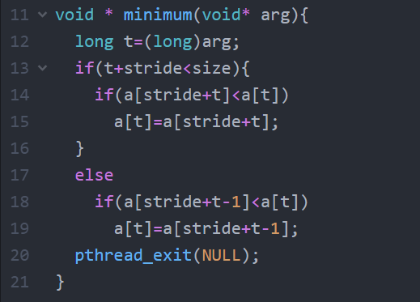
More detail
It seems we need to modify our code a bit:
Just last thread executes these lines
I just add a short condition: if the t+stride=size then
I use “t+stride-1” instead of “t + stride”.
With this condition we reach below state:
9 8 2 1 5 4 7 3 0
This is t+stride-1

Slide 13
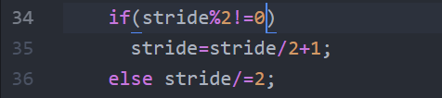
More detail
As you saw in previous slide, the last element will be compared twice which doesn’t matter
By below code If the stride/2 is not integer, I get it’s ceil:
In our example when stride=9:
9%2=1 which is != 0
Stride=9/2+1=4+1=5
And we get 5 instead of 4.5 easily.

Slide 14
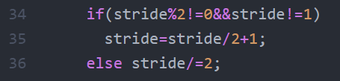
More detail
2. Second problem: in our solution for computing the ceil, in previous slide, our program never terminates:
Suppose we are in end of the process and stride = 1:
By Stride=1
1%2=1 which is != 0
stride = 1/2 +1=0+1=1
OOPS
The value of stride is 1 again.
It means the stride will be 1
For ever
How to solve it??
Just add a simple and short condition: →

Slide 15
More detail
There is no more detail ☺
I think I said all important points about question and my code.
if you have any question, feel free to ask:
ask in LMS.iut.ac.ir
or milad_golgolnia@yahoo.com
Have Fun

